Slide 1
Cisco IT TOMORROW Starts Here
Notes:
Slide 1
In this presentation we will talk about what you about what YOU can do to help make sure we deliver the most compelling brand experience possible.
We will begin with a brief overview of our brand strategy. Then we’ll give you an overview of the new brand campaign. Our goal is to give you a good understanding of how you can join us on this journey.

Slide 2


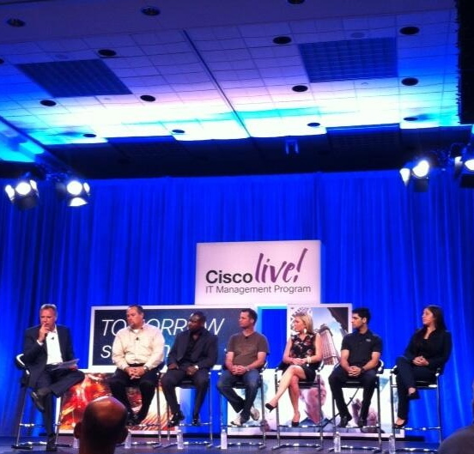
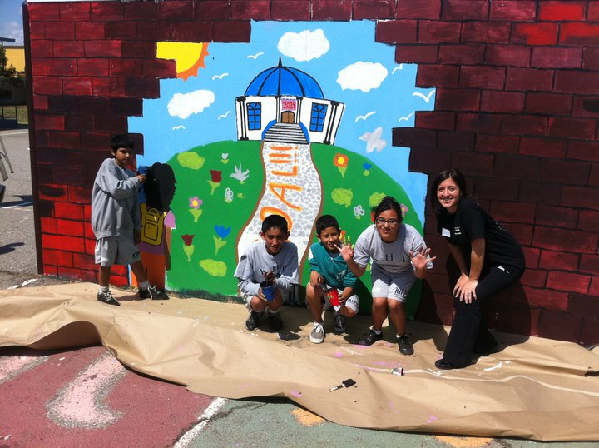

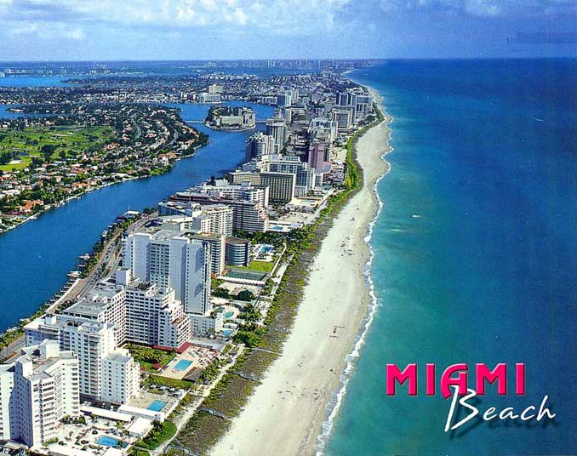
Who Am I? Lorena Valentin IT Analyst – LatAm IT Class of ‘12
University Connection
Notes:
You have our commitment. Our promise.
We will help you seize the opportunities of tomorrow—today.
Thank You.

Slide 3








Who Am I? Brad Giles IT Engineer - TRIAD IT RPI Class of 1992
University Connection
Notes:
You have our commitment. Our promise.
We will help you seize the opportunities of tomorrow—today.
Thank You.

Slide 4
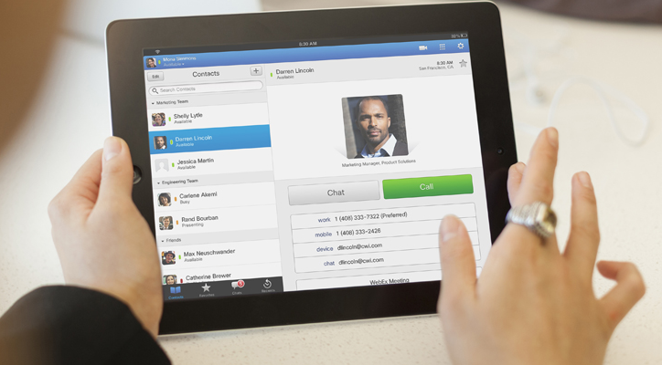
Information Technology
Roles
Competencies
Qualifications
IT Analyst
Self-motivated and highly ambitious
Creative problem solving skills
Strong communication skills
Excellent teamwork and people skills
Ability to manage multiple tasks and work towards long-term goals
BS or BA degree in Business Administration with a concentration in Information Systems, Industrial and Operational Engineering, Computational Degrees: Human Factors (user experience) and Computer Science.
Prior internship preferred, not mandatory
GPA Requirement: 3.2
IT Engineer
Excellent oral and written communication skills
Knowledge in developing web-based applications and programming languages
Strong sense of ownership and the ability to meet deadlines and commitments
Ability to multi-task, self-start, work in a fast-paced team environment and work independently
BS or BA degree in a technical field. (Computer Science, Computer Engineering, Electrical Engineering, and Industrial & Operational Engineering
Prior internship preferred, not mandatory
GPA Requirement: 3.2
Make sure to apply ONLINE at https://communities.cisco.com/community/general/universityconnection
and JobLink
Notes:
PT- Slide #1
Story and Vision - Be the change I want to see in the world
Roles and Markets -
Opportunity - Where will I find myself working?

Slide 5
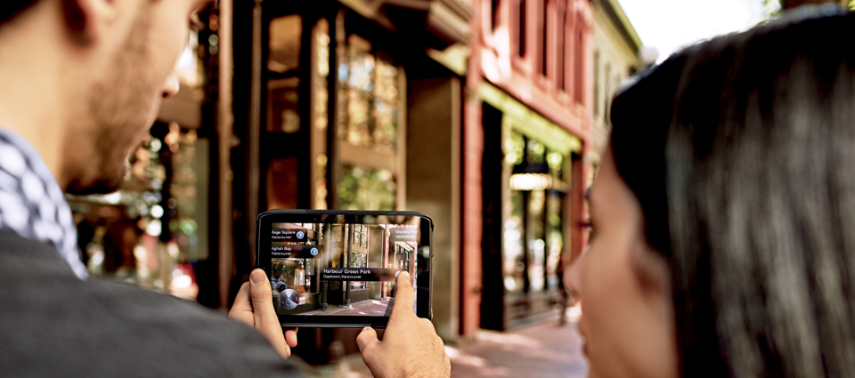
Next Steps
Cisco at RPI
SWE Evening with Industry on Thursday, September 26
Career Fair on Friday, September 27 & Saturday, September 28
On-Campus Interviews September 27 – 29 for IT and Services
Resume Submission Deadline on September 30 for Engineering Interviews on October 9

Slide 6




IT Vision and Strategy
Unify the business and technology architectures through IT Services. We will continue to deliver on all three vectors:
Technology
Process
Culture
Vision
To be the #1 IT Company in the world
Strategy
Notes:
Our vision is to change the way the world works, lives, plays, and learns.
And this is driven by our strategy, which is to solve our customers’ most important business challenges by delivering intelligent networks and technology architectures built on integrated products, services, and software platforms.
The most fundamental way we view our strategy is around the idea of change, and how change affects our customers. For instance, the market transitions that have the most impact on our customers define our competitive opportunities.
We’re also committed to simplifying complex technology—with the goal of solving real business problems and opening up exciting new opportunities.
Ultimately, it’s about what we make possible for you to do.
Grow
Build
Innovate
Compete
And we also understand that you’re no longer just looking for a technology provider. You want a strategic partner who understands your needs and can help transform your business.

Slide 7
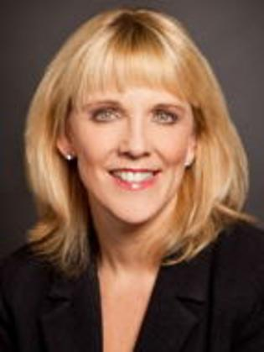
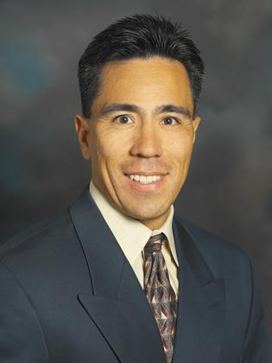
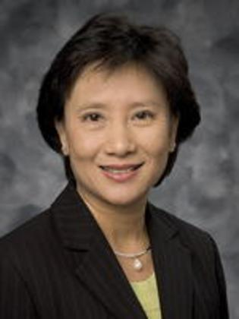
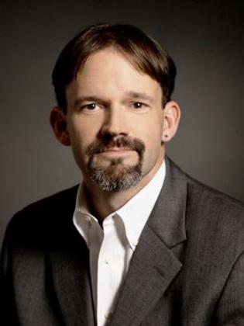
IT Organizations
IT Communication & Collaboration
The Communication and Collaboration IT organization is responsible for defining the vision, strategy, and execution of the Communication and Collaboration platform at Cisco for its employees, customers, and partners
Connected IT Services
Connected IT Services unifies Business and Technology Architectures by creating one Cisco Architecture accelerating business strategy, delivering new business models and providing industry and Cisco technology leadership on the network as the platform.
Cisco Value Chain IT
From quoting through delivery, Cisco Value Chain IT connects people, processes, policies, and systems to accelerate Cisco’s business strategy. With identity & access and master data services, Quote-to-Order, embedded with external business integration, CVC delivers competitive advantage to our Value Chain.
Corporate Security Programs Organization
Serves Cisco as a consultative partner, developing programs and policies that support security efforts and align them with Cisco's business strategy.

Slide 8
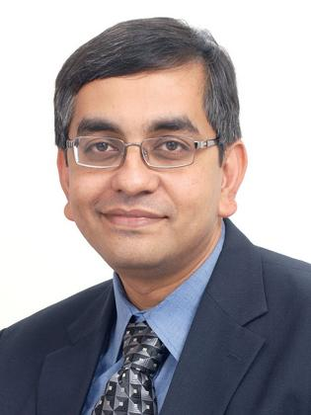
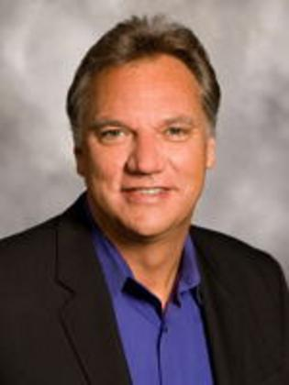
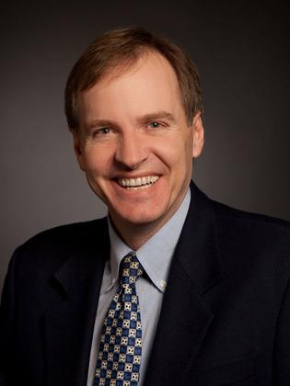
IT Organizations
Globalisation IT
Globalisation IT provides a platform for Cisco to lead market transitions and to capitalize on growth potential around the world. This team focuses on unifying core business and technology architectures to deliver innovation, operational excellence and improved client experience.
IT Customer Strategy and Success
IT CS&S collaborates with development groups inside Cisco in driving innovation and integration of products and systems that enhance customer success. The organization also includes the IT Acquisitions Integration Team, which integrates the IT of acquired companies into Cisco and the IT College Program
Global Infrastructure Services
IT Global Infrastructure Services delivers foundational services and leads architecture, design and implementation for Cisco’s data centers and networks, providing the technology infrastructure for Cisco’s global workforce. It is our responsibility to prepare the network to deliver everything as a service.

Slide 9

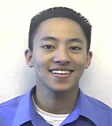
Meet The People of Cisco IT: IT Analyst
Why did you decide to work for Cisco?
Cisco is a leading company in IT. I wanted to go to a place where I could learn, play, and work with the newest technologies in the world and Cisco provides that.
What do you enjoy most about working at Cisco?
I get to do my work using the latest technologies in the world like Telepresence and Cisco Quad social networking platform. Also, the flexibility Cisco offers cannot be matched. I am not locked into specific work hours nor am I chained to my desk every day, which has eased the stress of attending graduate school part time.
What is the most interesting aspect of your job?
I’m learning how Cisco IT services and technologies are deployed within Cisco. Being exposed to the end-to-end business process is invaluable.
Name: Anthony Vu
IT Organization: Emerging Technologies Deployment
Office Location: San Jose, California
Education: BS Business Management, Info Systems
University: California State University

Slide 10
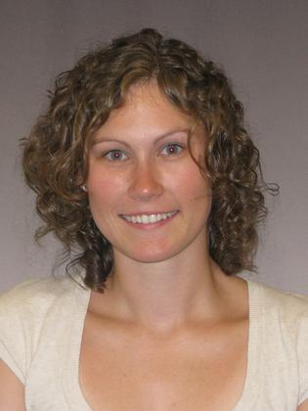
Meet The People of Cisco IT: IT Engineer
Why did you decide to work for Cisco?
I became interested in networking thanks to the Cisco Net Academy during High School. So, I have basically worked on Cisco equipment most of my life. Considering that I had a degree in Networking, I wanted to work for the best company in the industry.
What do you enjoy most about working at Cisco?
I love the fact that despite how large Cisco is, it’s easy to get to know people. I know my director and VP on a personal level and I was able to ask John Chambers, our CEO, a question in our recent All Hands. Also, I love Cisco’s strong commitment to philanthropy and that we are encouraged to take time to volunteer.
What is the most interesting aspect of your job?
The role of IT is to keep Cisco running. However, IT is also a springboard to test our new products so that we can demonstrate their deployment and business value to customers. I’m constantly involved with cutting edge technology through our network.
Name: Liz Kiewiet
IT Organization: Network and Data Center Services
Office Location: Raleigh, North Carolina
Education: BS Applied Networking and Systems Administration
University: Rochester Institute of Technology, New York

Slide 11
IT VSEM
V
Lead Every Move We Make with Networked IT
S
Unify the Business and Technology Architectures with Services Oriented Everything
Virtualization
Decision Making Advantage
Globalisation
Communication and Collaboration
Business Model Enablement
Leadership
Borderless Networks
E
Technology
Process
Culture
Video
Service Playbook
IT Change Mgmt Team
Security
Virtual Desktop Infrastructure
IT Cohorts
Data/Content
Data Center
Systems Management
Career Workgroup
Eco–system
M
Measure Success
Growth
Experience
Productivity
Time to Capability
Replication
Flexibility
Scale
Speed
Notes:
Cisco: Information Technology
VSE…Vision, Strategy, Execution
This is a single page view that we use at Cisco to provide direction. Strategy covers 3-5 years and Execution covers 12-18 months.
It’s really a guidepost to the entire IT organization about where we are going and how we are going to get there.
To drive transformational change, our strategy is all about unifying business and technology architecture and our execution plans cover technology, process and culture.
I’d like to point out our measures of success…we need a step function improvement to lead every move Cisco makes

Slide 12

Call To Action
APPLY ONLINE TODAY
@
cisco.com
CISCO IT UNIVERSITY PROGRAM

Slide 13

“Cisco helps you make the most of tomorrow’s opportunities.”
Notes:
You have our commitment. Our promise.
We will help you seize the opportunities of tomorrow—today.
Thank You.

Slide 14
Thank You

